Slide 1


Department of Computer Science & Engineering Mini Project On Suggesting proper crop using field types
CMR ENGINEERING COLLEGE
(UGC AUTONOMOUS)
(Accredited by NBA, Approved by AICTE NEW DELHI, Affiliated to JNTU, Hyderabad) Kandlakoya, Medchal Road, Hyderabad-501 401
Internal Guide:-
Mrs.S.Anitha,
Assistant Professor,
Dept. of CSE.
By
B Sai Krishna Goud
K Rosi Reddy
S S Harshitha
G Nithin Koushik
A.Y 2022-2023
: 198R1A0507
: 198R1A0525
: 198R1A0547
: 198R1A0514

Slide 2
Table of Contents:
Introduction
Abstract
Literature survey
Existing System
Existing system with limitations
Proposed System
System Configuration
Finding of project
Data flow diagrams
UML Diagrams
System Architecture
Screen Shots
Conclusion
References

Slide 3
ABSTRACT
Agriculture and its allied sectors are undoubtedly the largest providers of livelihoods in rural India. The agriculture sector is also a significant contributor factor to the country’s Gross Domestic Product (GDP). However, regrettable is the yield per hectare of crops in comparison to international standards. This is one of the possible causes for a higher suicide rate among marginal farmers in India.
we have designed the system using machine learning algorithms for betterment of farmers. Our system will suggest the best suitable crop for particular land based on content and weather parameters. The proposed system provides connectivity to farmers via a website. GPS helps to identify the user location. The user provides the area & soil type as input.

Slide 4
Machine learning algorithms allow choosing the most profitable crop list or predicting the crop yield for a user-selected crop. To predict the crop yield, selected Machine Learning algorithms such as Support Vector Machine (SVM), Artificial Neural Network (ANN), Random Forest (RF), Multivariate Linear Regression (MLR), and K-Nearest Neighbor (KNN) are used. Among them, the Random Forest showed the best results with 95% accuracy.

Slide 5
INTRODUCTION
Agriculture, as we all know, is the foundation of the Indian economy. Agriculture is an important occupation in India. More than 60% of the country's land is used for agriculture, which feeds 1.3 billion people .
Agriculture is the cultivation of plants and animals. In India, agriculture gave rise to civilization. We need soil to cultivate crops. As a result, soil is a critical factor in agriculture.
Soil health is essential for good food production. It provides the roots with essential nutrients, water, oxygen, and support. Soil is the foundation of the food system, as well as the location of all plants used in food production.
In India, several soil varieties are available. They are alluvial soil (cotton, rice), black soil (sugarcane, sunflower), red soil (corn, ragi), laterite soil (pulses, tea, coffee), and so on.

Slide 6
Many studies have been conducted to improve agricultural planning. The crop can be recommended using a machine learning technique.
Machine learning is an subfield of artificial intelligence that describes a machine's ability to mimic intelligent human behaviour. Artificial intelligence systems are employed in the same way as humans do to automate complex tasks. Machine learning begins with data, such as financial transactions, individuals, or photos. The information is collected and processed to be utilized as training data for the machine learning system. If the data is more then the software shows better results. After that, the developer select a ML model to use, input the data, and train the system to find patterns or make predictions on its own.

Slide 7
LITERATURE SURVEY
A study of machine learning algorithms was conducted in a research paper by Rashi Agarwal. This system would help farmers make educated decisions about which crops to grow based on a variety of environmental and geographical factors. They employed decision trees, KNNs, Random Forests, and neural networks. The neural network had the highest accuracy of all of them.
Priyadarshini conducted a study on machine learning algorithms in her research article. This technology reduces crop failure and decreases productivity by supporting farmers in choosing the proper crop and provide the data that regular farmers do not maintain.
Mayank conducted research on crop yield prediction using a data mining technique. They used a random forest classifier because it can perform classification and regression tasks. The user-friendly website built that can be used by anyone to predict crop yield for their choice of crop by giving climate data for that area.

Slide 8
EXISTING SYSTEM
One of the early works developed a dedicated website to assess the impact of weather parameters on crop production in the identified districts of Madhya Pradesh. The districts were selected on the basis of the region covered by the crop. Based on these criteria, the first five top districts with a maximum crop area were chosen.
The basis of the crops selected for the study was on prevailing crops in the selected districts. The crops picked included maize, soybean, wheat and paddy, for which the yield for a continuous period of 20 years of knowledge, were tabulated. The accuracy of the established model ranged from 76% to 90% for the chosen crops with an average accuracy of 82%.

Slide 9
The system used both supervised as well as unsupervised ML algorithms and compares the results of the two.
Disadvantages:
1) An existing model doesn't predict the crop yield for the data sets of the given region.
2) The data sets are not cleaned and pre processed. The null values are not replaced with mean values.

Slide 10
PROPOSED SYSTEM
In the proposed system, the system has proposed a model that addresses these issues. The novelty of the proposed system is to guide the farmers to maximize the crop yield as well as suggest the most profitable crop for the specific region. The proposed model provides crop selection based on economic and environmental conditions, and benefit to maximize the crop yield that will subsequently help to meet the increasing demand for the country's food supplies. The proposed model predicts the crop yield by studying factors such as rainfall, temperature, area, season, soil type etc.
The existing system which recommends crop yield is either hardware-based being costly to maintain, or not easily accessible. The proposed system suggests a website that precisely predicts the most profitable crop by predicting the crop yield

Slide 11
SYSTEM REQUIREMENTS
SOFTWARE REQUIREMENTS:
➢ Operating system : Windows 7 Ultimate.
➢ Coding Language : Python.
➢ Back-End : Django-ORM
➢ Designing : HTML, CSS, JavaScript.
➢ Data Base : MySQL (WAMP Server).

Slide 12
HARDWARE SYSTEM CONFIGURATION:
➢ Processor - Pentium –IV
➢ RAM - 4 GB (min)
➢ Hard Disk - 20 GB
➢ Key Board - Standard Windows Keyboard
➢ Mouse - Two or Three Button Mouse
➢ Monitor - SVGA (super video graphics array)

Slide 13
Findings of the project
Algorithms used:
Logistic Regression.
K Nearest Neighbour.
Decision Tree Classifier.
Random Forest Classifier.
Naive Bayes.

Slide 14
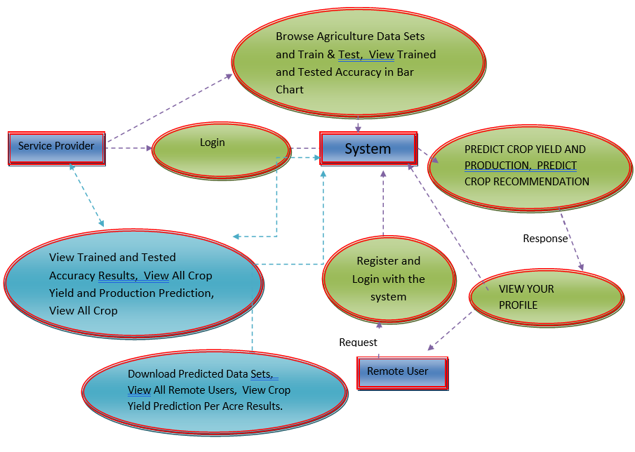
DATA FLOW DIAGRAM:

Slide 15
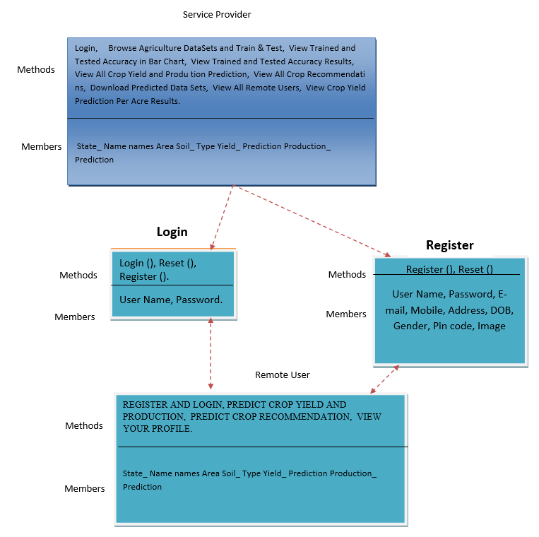
Class diagram:

Slide 16
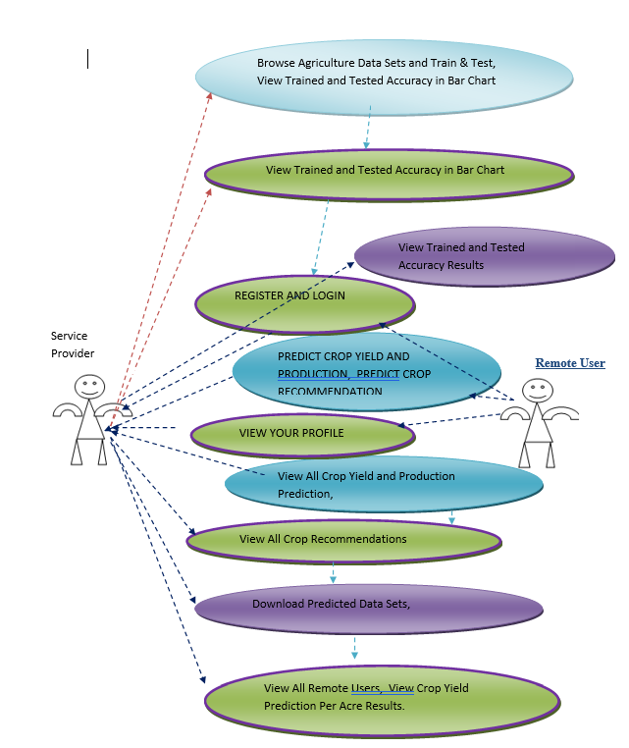
Use Case diagram:

Slide 17
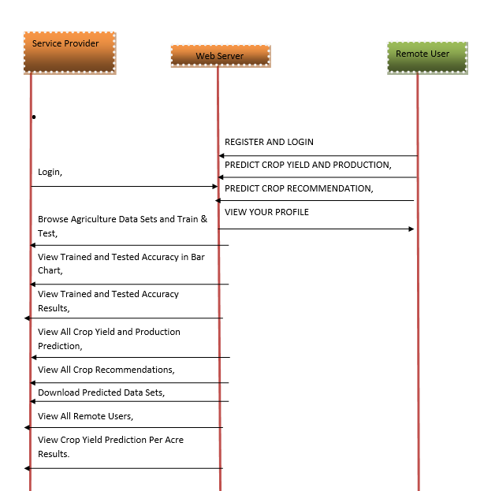
Sequence diagram:

Slide 18
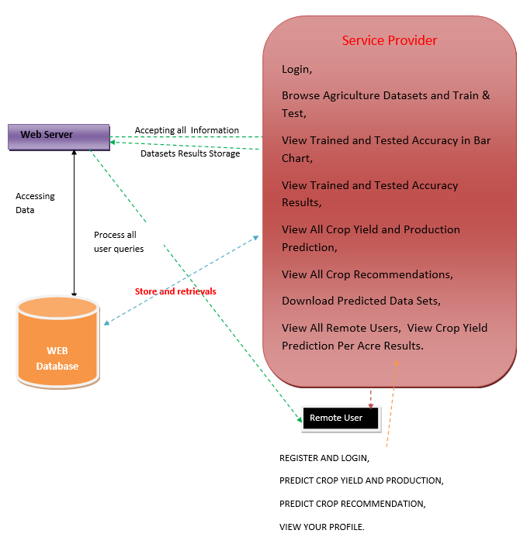
SYSTEM ARCHITECTURE:

Slide 19
TESTING TECHNIQUES USED:
Unit Testing.
Integration Testing.
User Acceptance Testing.
Output Testing.
Validation Testing

Slide 20
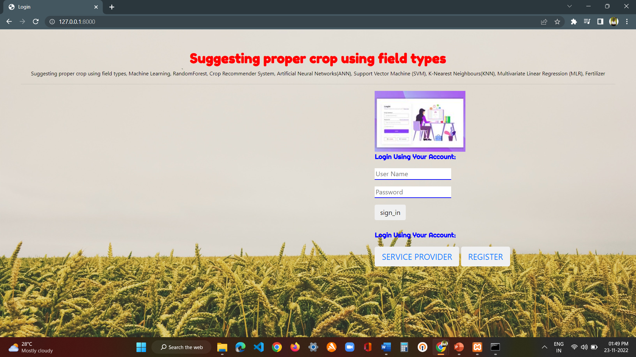
Output screens:
Fig: Login page

Slide 21
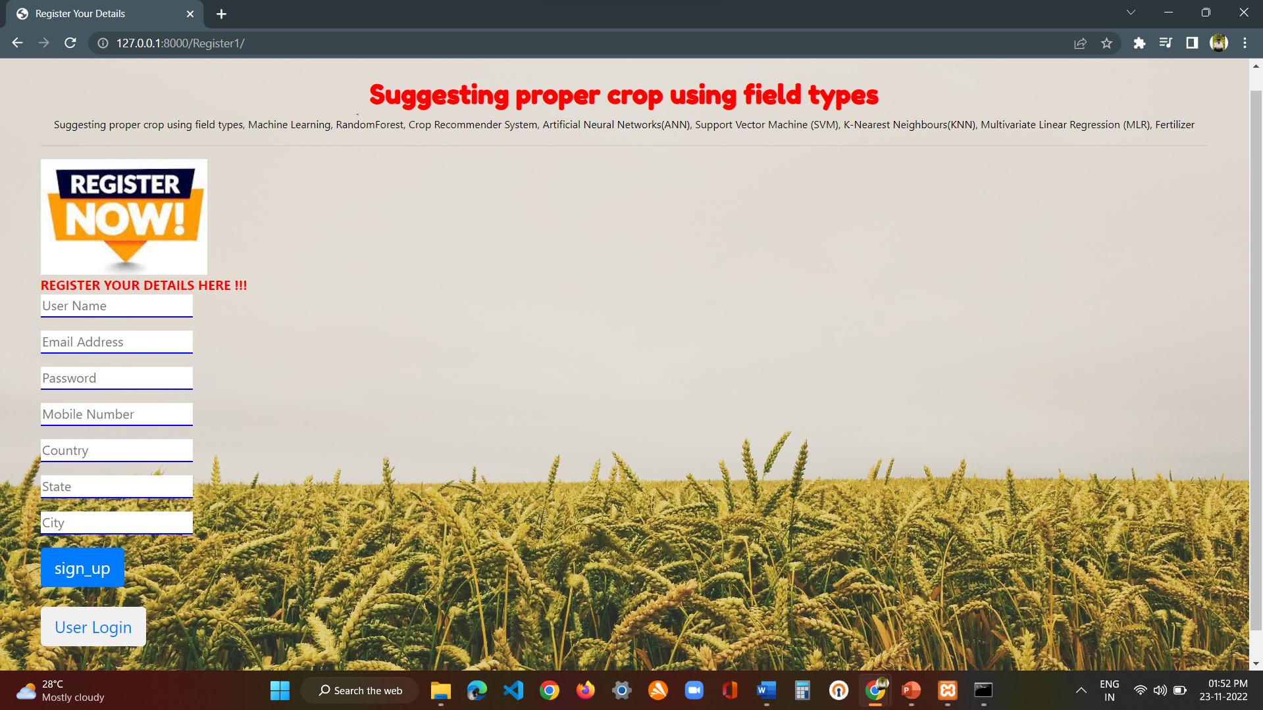
Fig : Register page

Slide 22
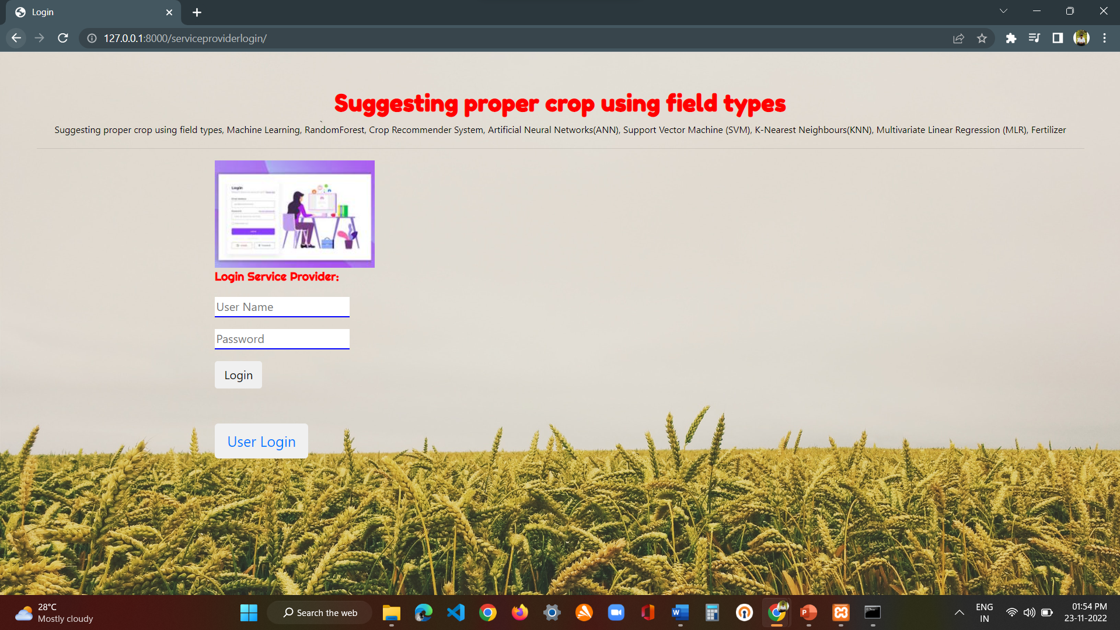
Fig : service provider page

Slide 23
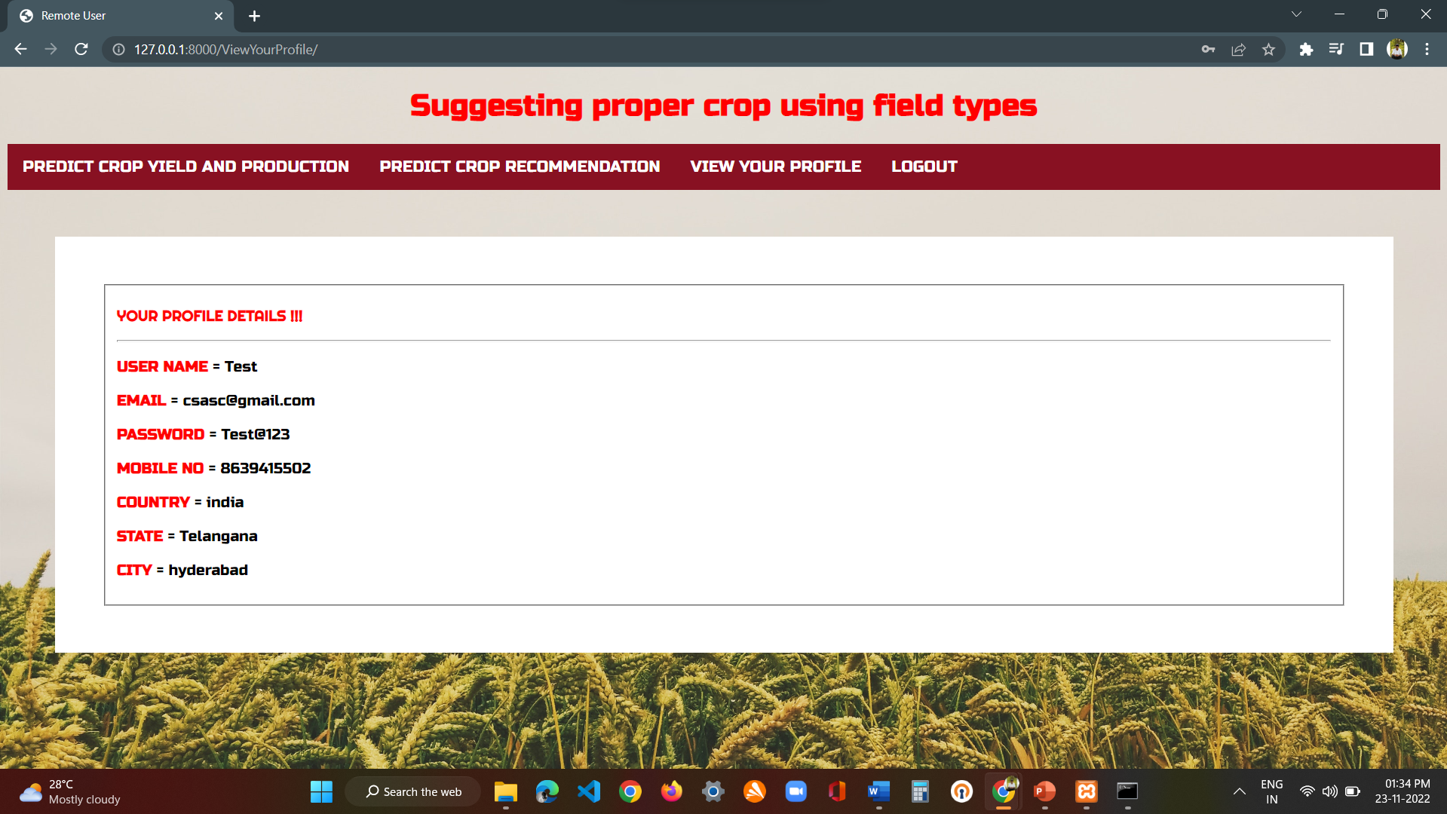
Fig: login->view your profile page

Slide 24
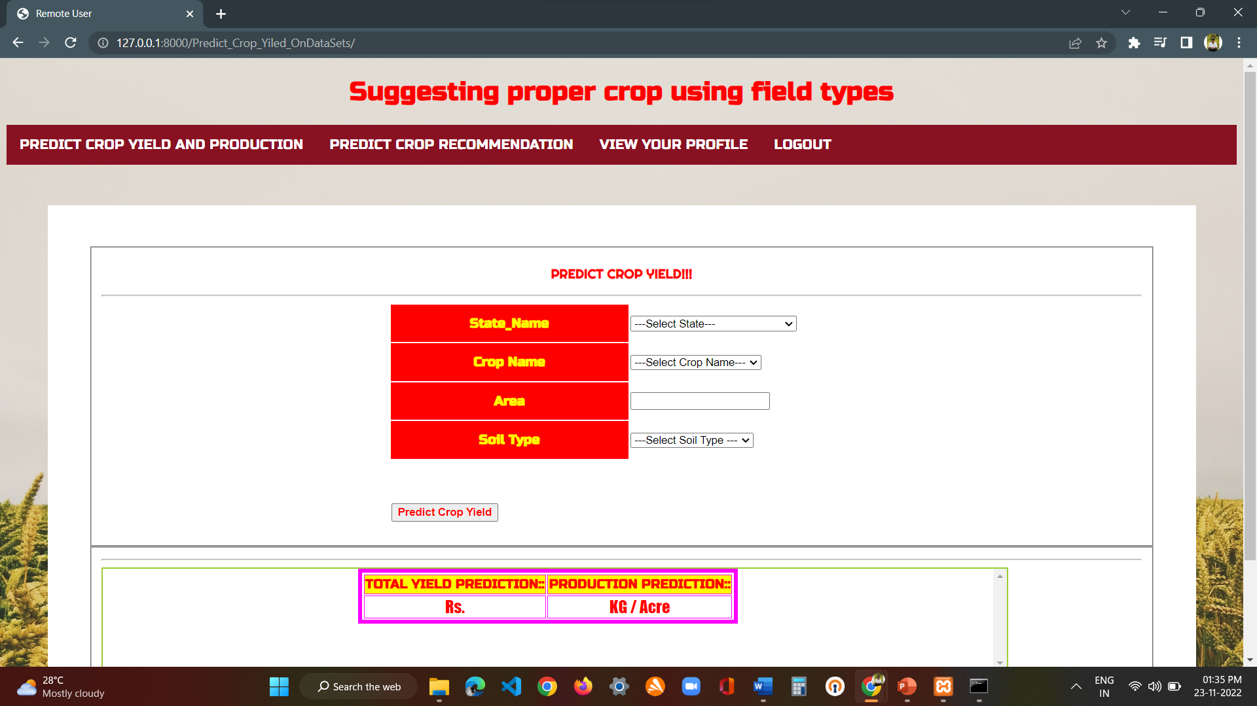
Fig: user login->predict crop yield and production page

Slide 25
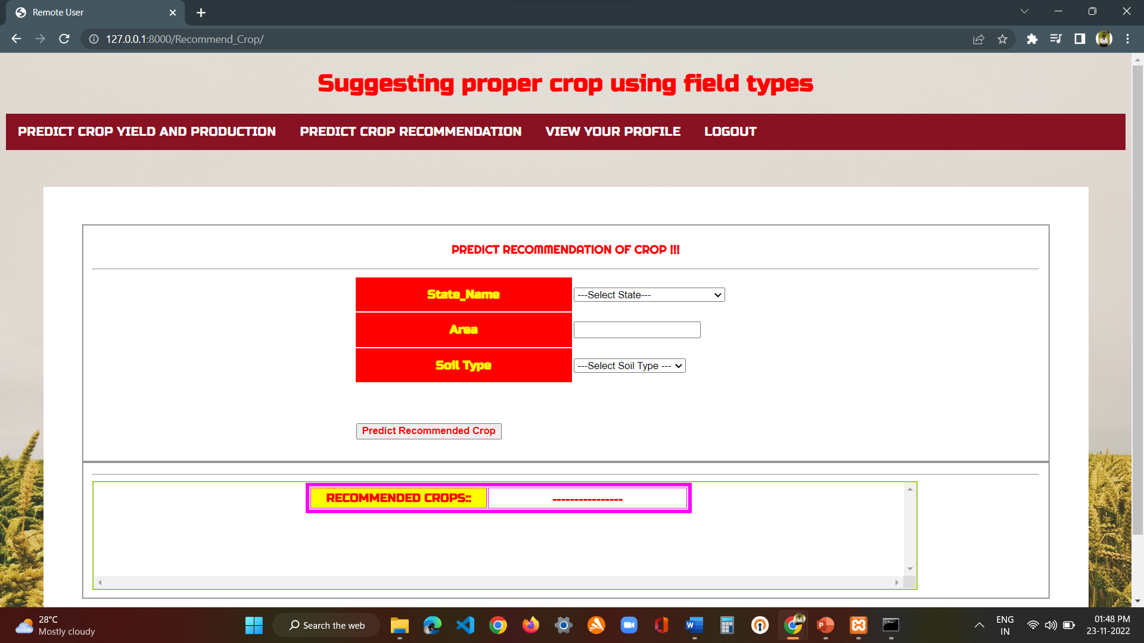
Fig : user login-> predict crop recommendation

Slide 26
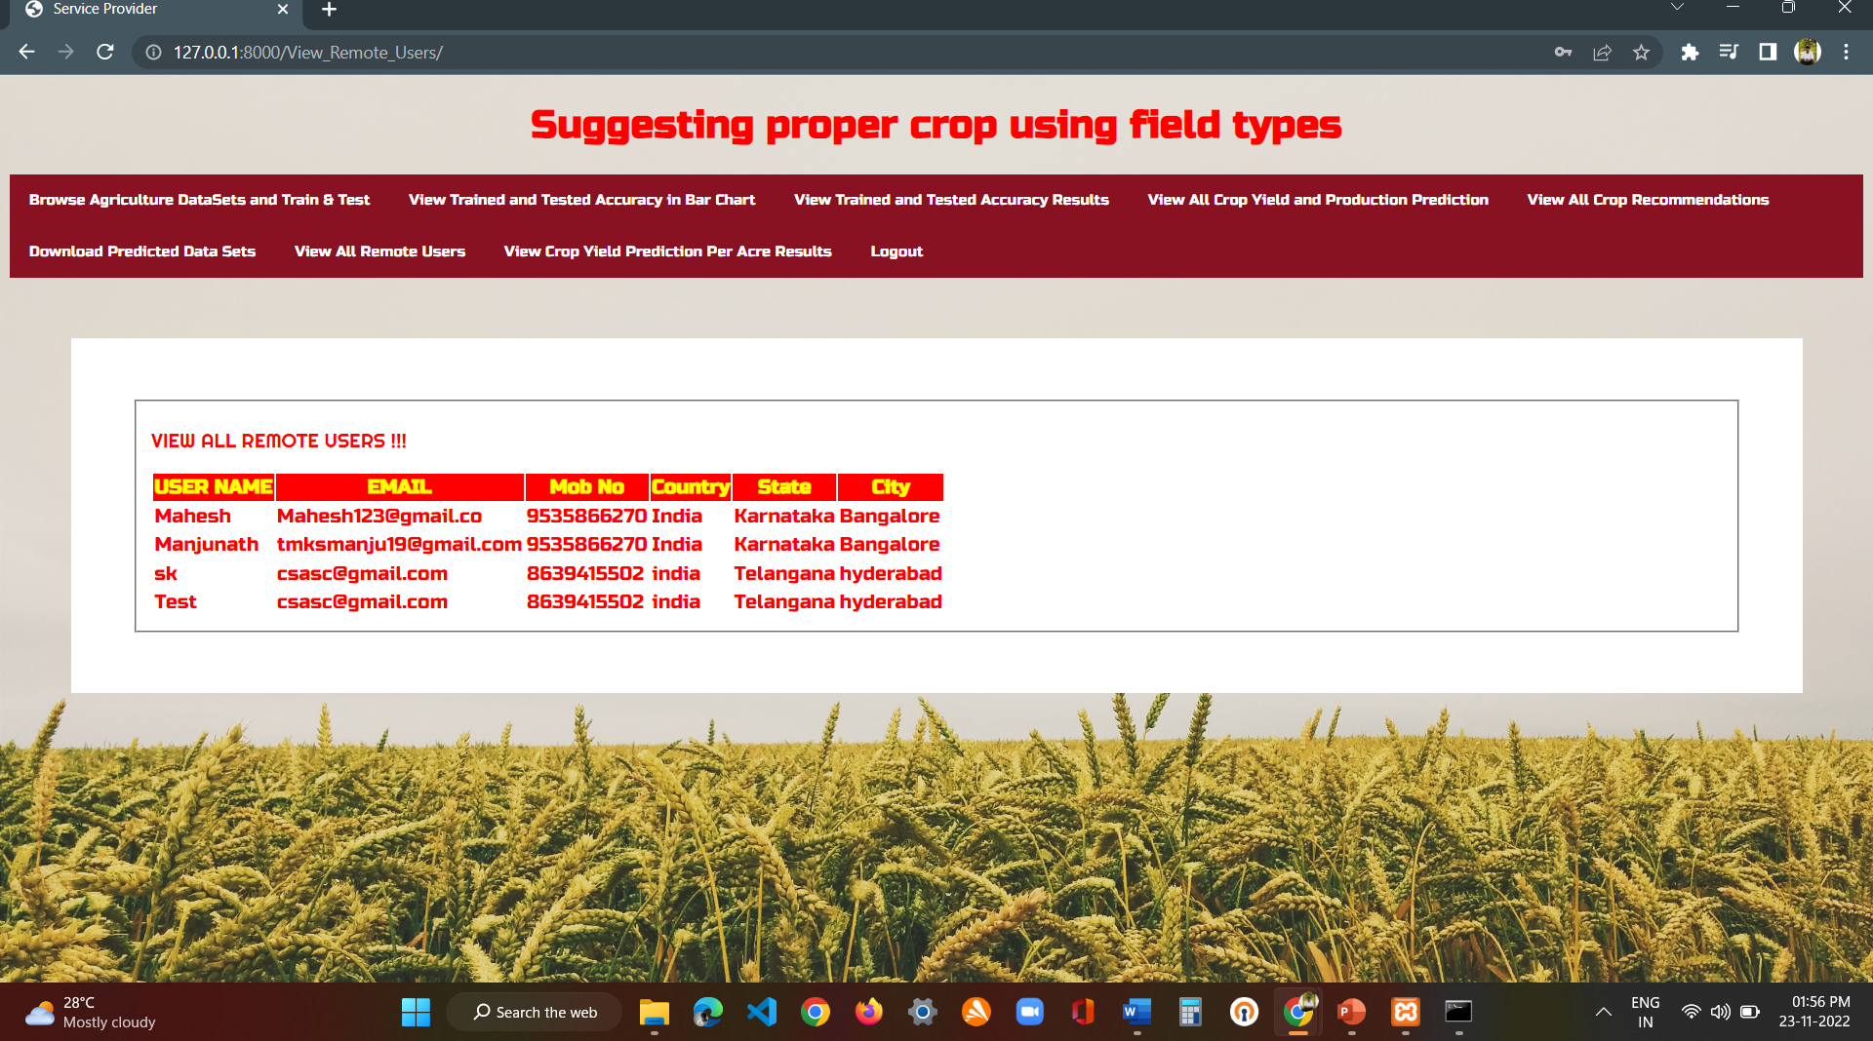
Fig : Service provider->view all remote user page

Slide 27
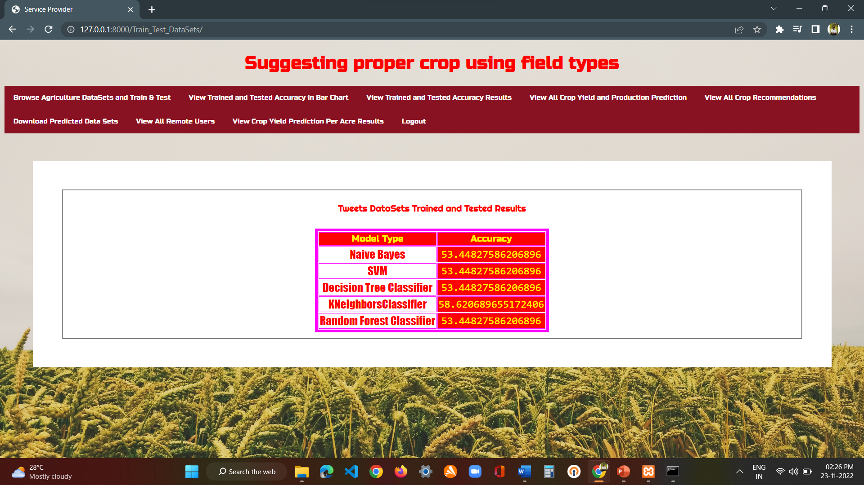
Fig : Service provider->browse agriculture datasets and train test

Slide 28
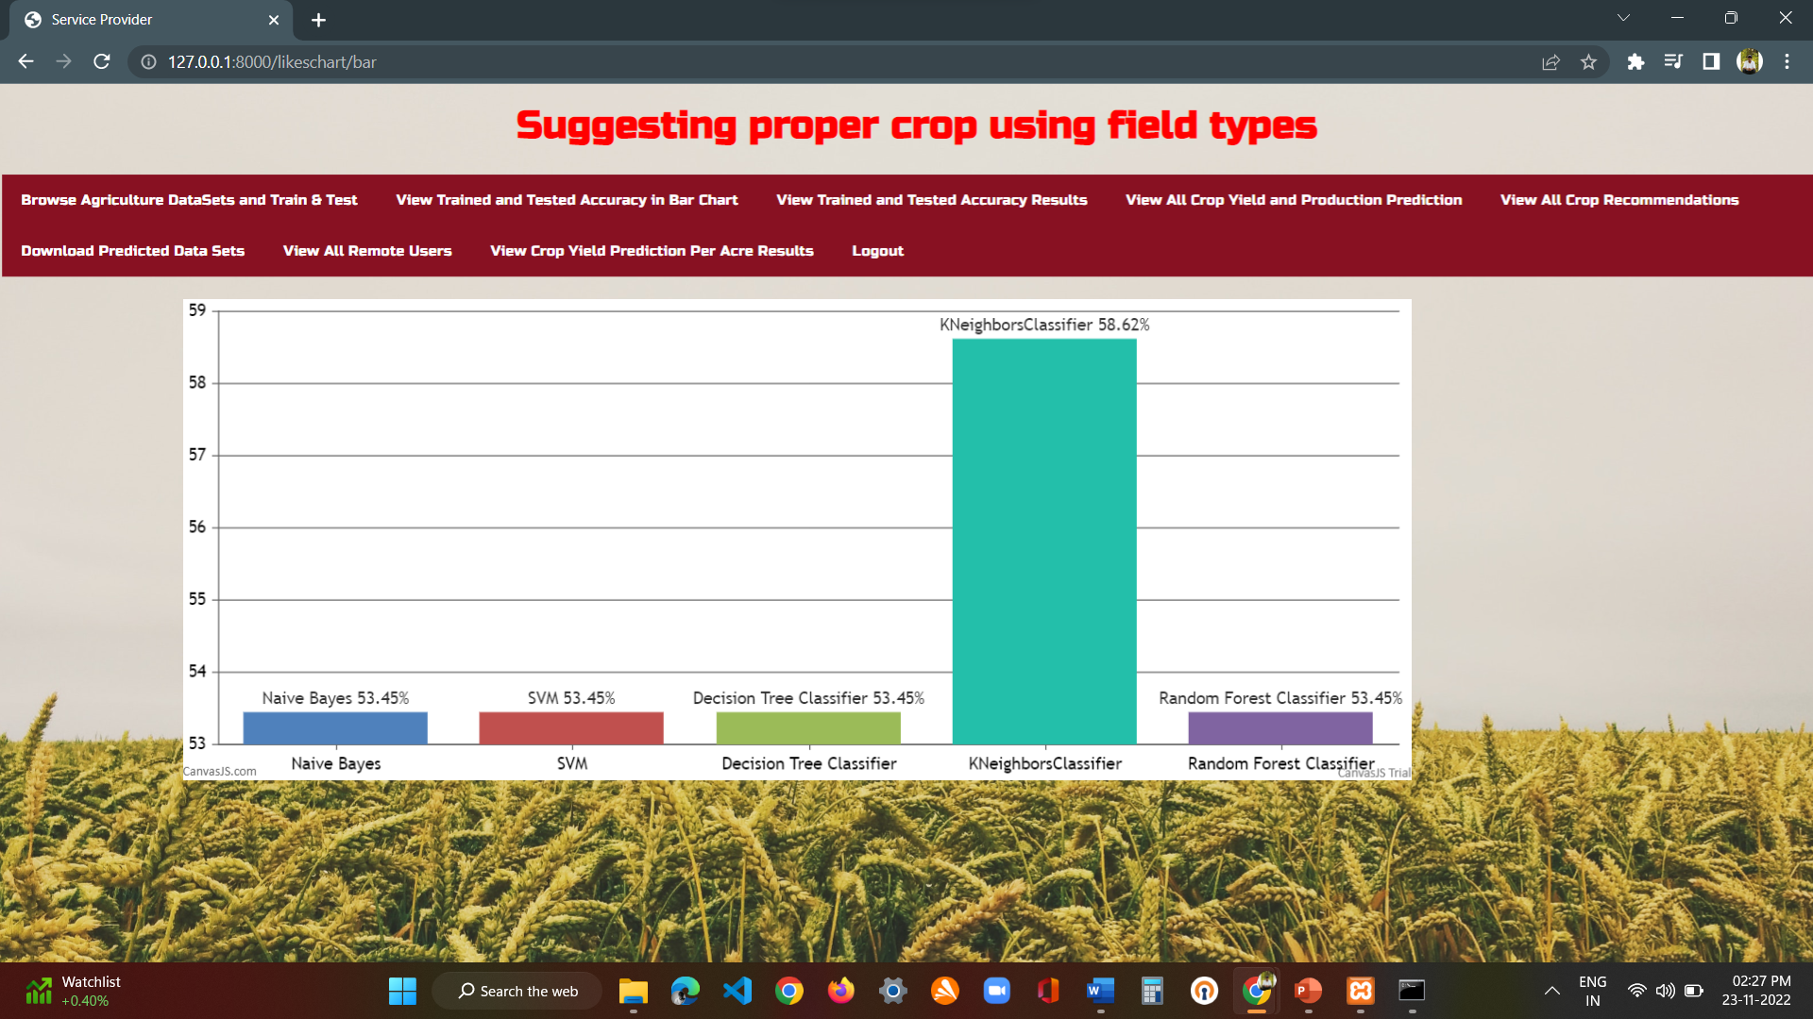
Fig : Service provider->view trained and tested accuracy in bar chart

Slide 29
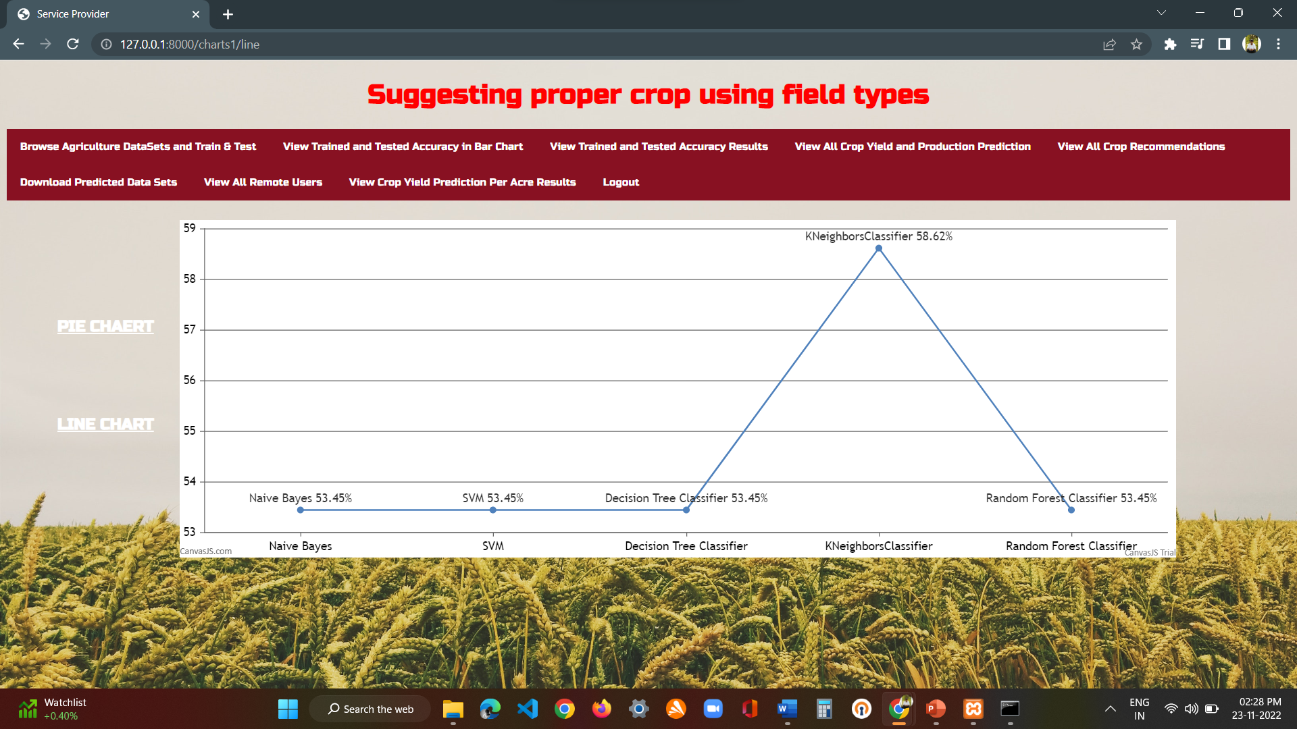
Fig : Service provider->view trained and tested accuracy results

Slide 30
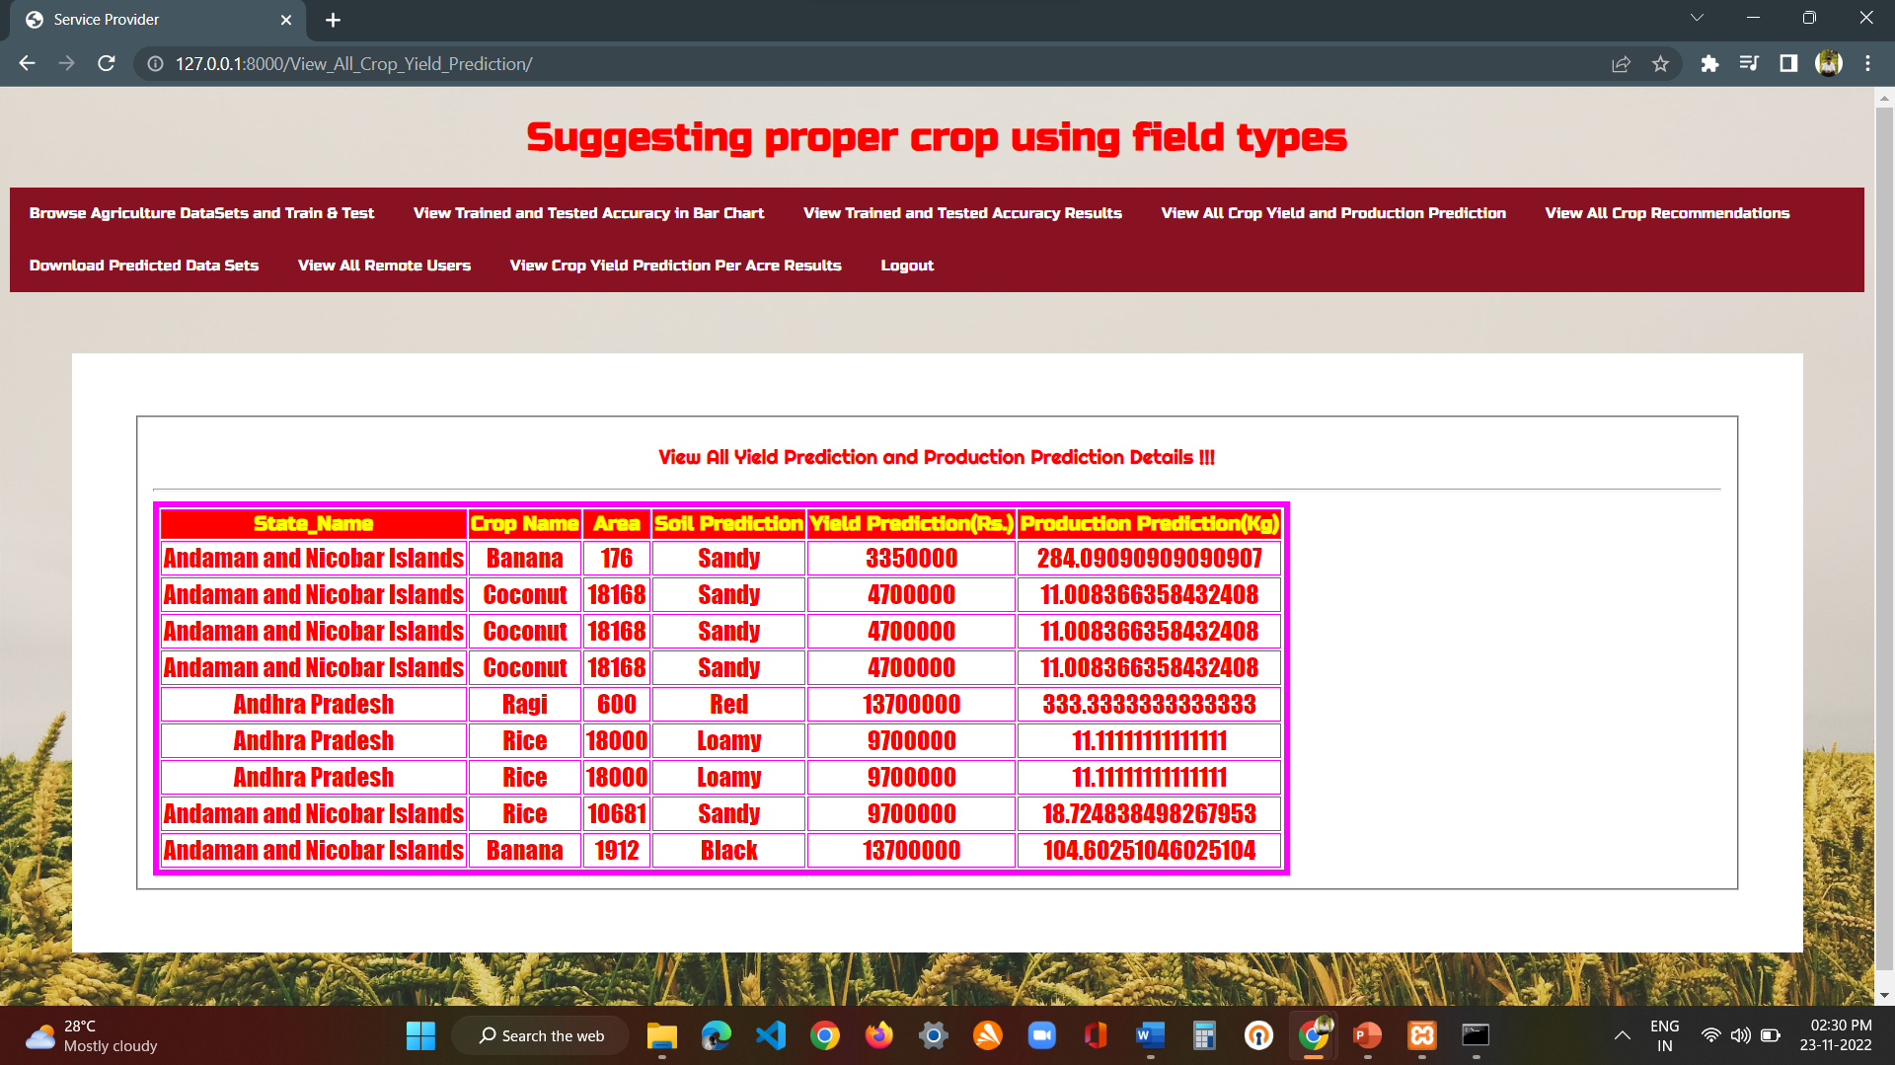
Fig : Service provider->View All Yield Prediction and Production Prediction Details

Slide 31
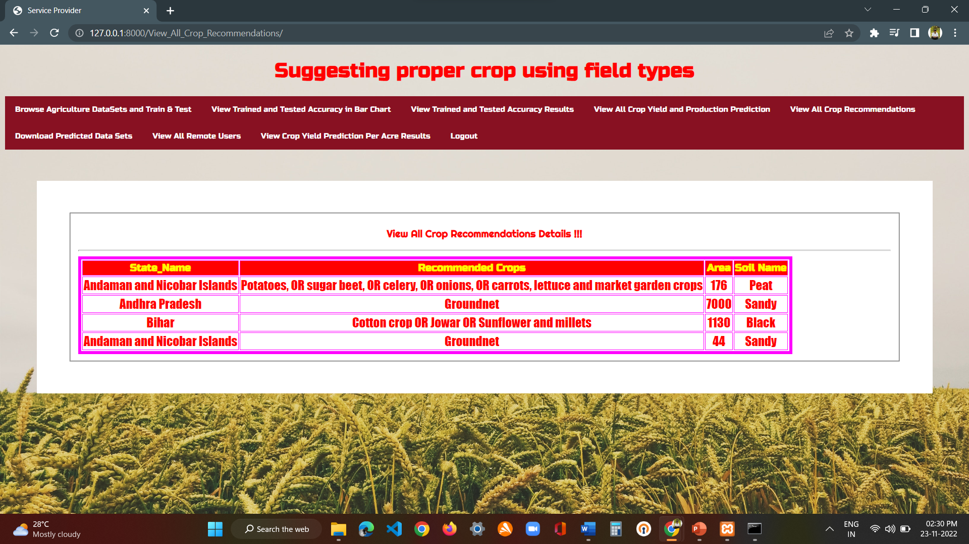
Fig : Service provider->View All Crop Recommendations Details

Slide 32
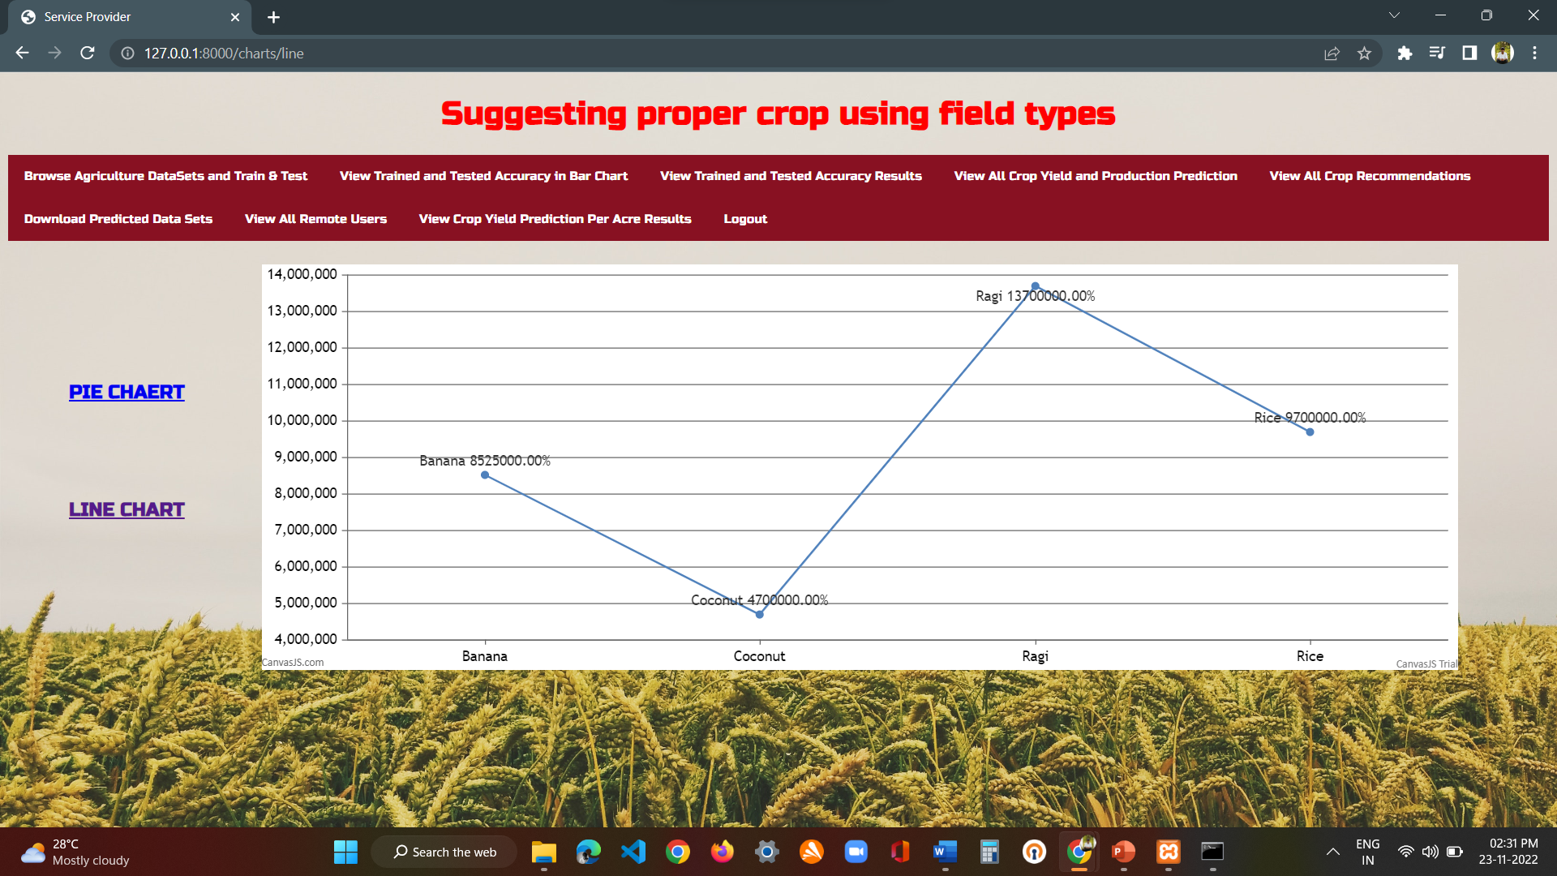
Fig : Service provider->view crop yield prediction per acre results

Slide 33
CONCLUSION:
This paper highlighted the limitations of current systems and their practical usage on yield prediction. Then walks through a viable yield prediction system to the farmers, a proposed system provides connectivity to farmers via a mobile application. The mobile application includes multiple features that users can leverage for the selection of a crop. The inbuilt predictor system helps the farmers to predict the yield of a given crop. The inbuilt recommender system allows a user exploration of the possible crops and their yield to take more educated decisions. For yield to accuracy, various machine learning algorithms such as Random Forest, ANN, SVM, MLR, and KNN were implemented and tested on the given datasets from the Maharashtra and Karnataka states. The various algorithms are compared with their accuracy. The results obtained indicate that Random Forest Regression is the best among the set of standard algorithms used on the given datasets with an accuracy of 95%. The proposed model also explored the timing of applying fertilizers and recommends appropriate duration..

Slide 34
Future enhancements:
The future work will be focused on updating the datasets from time to time to produce accurate predictions, and the processes can be automated. Another functionality to be implemented is to provide the correct type of fertilizer for the 1070given crop and location. To implement this thorough study of available fertilizers and their relationship with soil and climate needs to be done. An analysis of available statistical data needs to be done.

Slide 35
References
1.Johnson LK, Bloom JD, Dunning RD, Gunter CC, Boyette MD Creamer NG, “Farmer harvest decisions and vegetable loss in primary production. Agricultural Systems”, 2019 Nov 1;176:102672.
2. Jain A. “Analysis of growth and instability in the area, production, yield, and price of rice in India”, Journal of Social Change and Development, 2018;2:46-66
3. Manjula E, Djodiltachoumy S, “A model for prediction of crop yield ” International Journal of Computational Intelligence and Informatics,2017 Mar;6(4):2349-6363.
4. Wolfert S, Ge L, Verdouw C, Bogaardt MJ, “Big data in smart farming–a review. Agricultural Systems”, 2017 May 1;153:69-80.
5. https://web.dev/progressive-web-apps
6.https://www.wikipedia.org/

Slide 36
Thank you

